Slide 1
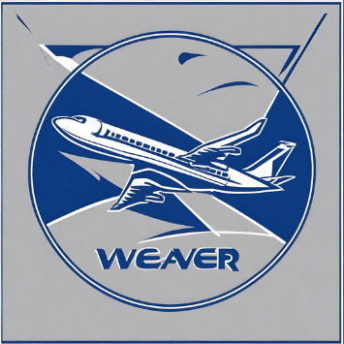
Airline safety executive summary
Ryan Weaver

Slide 2
PROBLEM
Public perception
Due to recent unfortunate airline crashes, the media has been promoting statistics stating air is no longer a safe way to travel.
CUSTOMERS
Since the media began promoting these statistics, cancelations have increased by 15%
FINANCIALS
Passenger flights account for 75% of our revenue.
COSTS
Underfilled flights are decreasing the revenue for each flight where are costs remain constant

Slide 3
Addressing media
FATALITY TRENDS
Looking at fatalities over time show the story of air travel being safer
AIRLINE FATALITIES
Weaver Airlines is not included in the top airlines with most fatalities
FATALITY LOCATION
Highest number of fatalities are in Asia, where we operate mainly in North America
WHY AIR TRAVEL IS THE SAFEST
Outlining the training, technologies, and the check and balances inherent in air travel

Slide 4
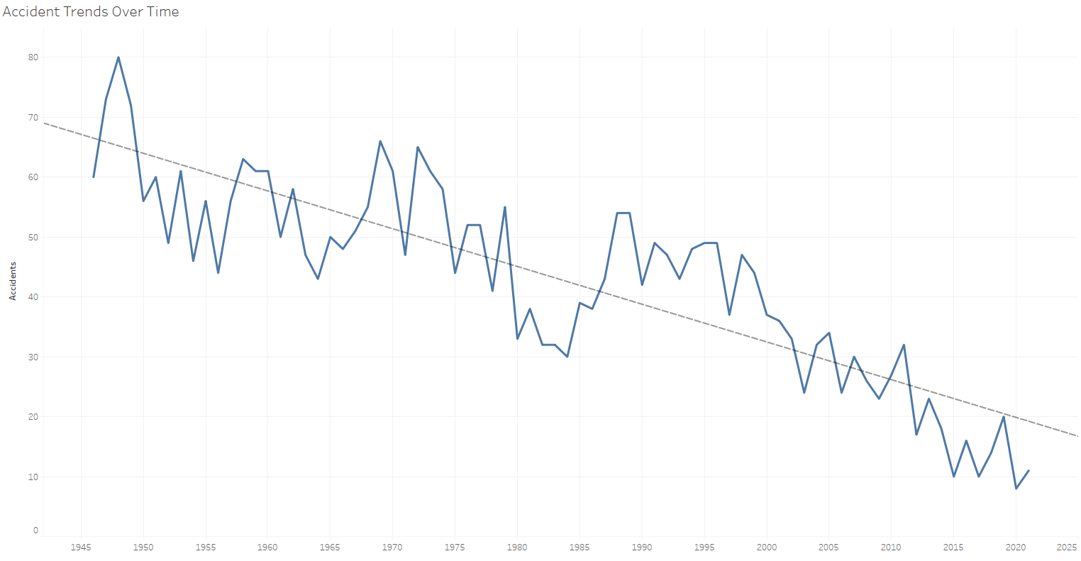
FATALITY Trends

Slide 5
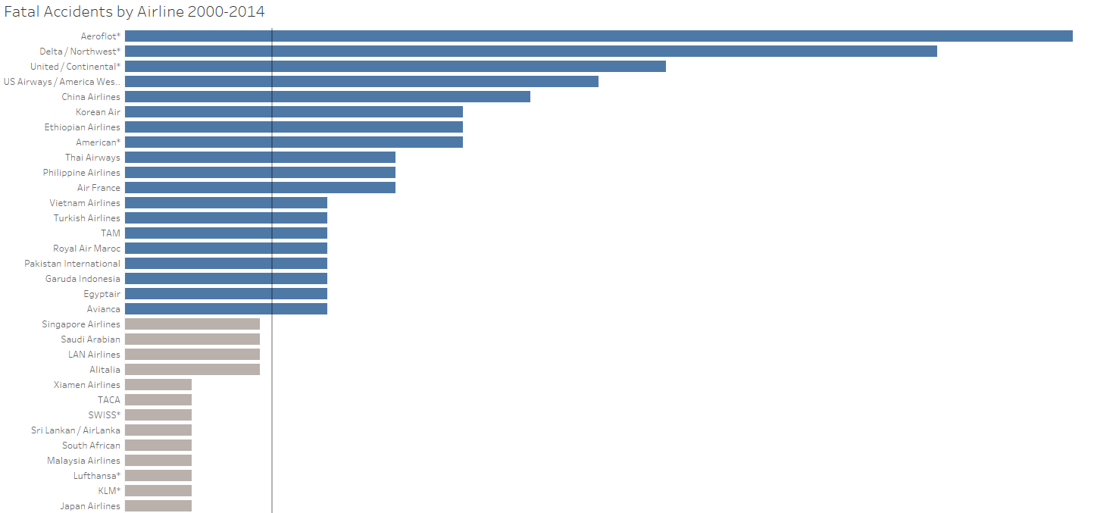
AIRPLANE FATALITIES

Slide 6
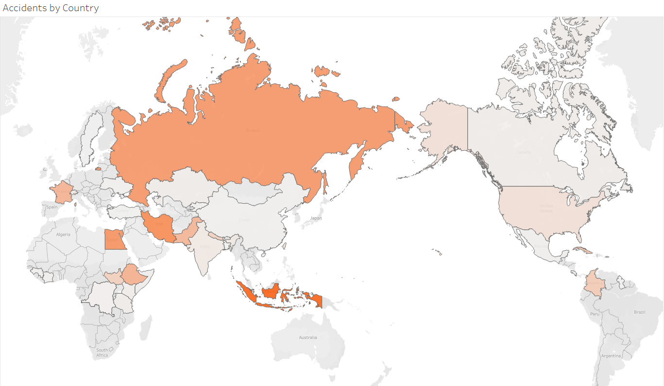
FATALITY LOCATION

Slide 7

Why is air travel the safest
Checks and Balances
Training
Technology
Regulations
Successful flights involve multiple divisions, including flight crew, air traffic control, and aircraft dispatchers, all of whom collaborate to ensure safety and accuracy in flight operations.
Obtaining a pilot's license and undergoing aircraft dispatcher training are challenging endeavors that require rigorous testing and significant experience, with pilots needing 1,500 flying hours to work as first officers on commercial airlines.
Aviation technology is rapidly advancing, with the latest Airbus and Boeing models equipped with extensive safety features, making them highly sophisticated in monitoring various aspects of flight.
Like how a machine monitoring driving behavior might result in multiple tickets, pilots, air traffic controllers, and aircraft dispatchers are closely monitored and regulated by the Federal Aviation Administration to ensure adherence to safety regulations, contributing to aviation safety.

Slide 8
SUMMARY
At Weaver Airlines, we believe in safety. With the visuals contained in this deck we expect to counter recent perception that airline travel is no longer one of the safest forms of travel. We thrive because we understand the risks and have preventions in place to minimize them.

